Slide 1


CVCS Escapement Modeling
Coding the CVCS Escapement Model
Presented by:
Arthur Barros, California Department of Fish and Wildlife
Arthur.Barros@wildlife.ca.gov

Slide 2
Session goals
Review the escapeMR package structure and methods.
Review the demo data.
Replicate CVCS escapement methods in R script.

Slide 3

Workshop GitHub
https://github.com/arthurbarros-CDFW/CVCS-Modeling-workshop

Slide 4




Prepping to code - packages
Packages:
tidyverse
escapeMR
ggplot2
rcpp
Writing functions in R
Writing “for loops” in R

Slide 5
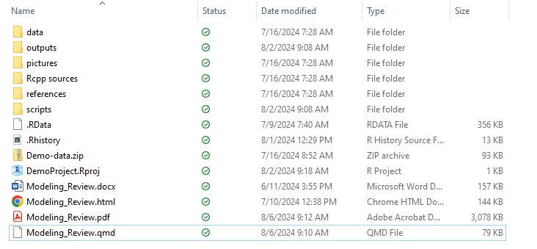
Prepping to code – project directory

Slide 6
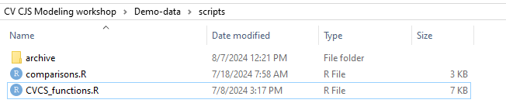
Prepping to code – project directory

Slide 7
Reviewing the escapeMR package

Slide 8
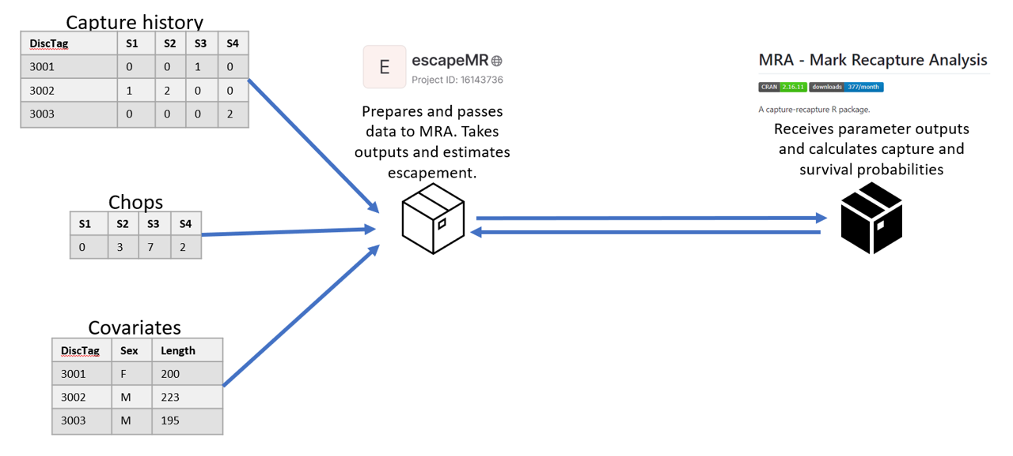
Reviewing the escapeMR package

Slide 9
Reviewing the escapeMR package
escapeMR:
escapeMR.R – loads and runs shiny application.
askForData.R – prompts user for data inputs.
CJSscript.R – script-based version of shiny application.
esc_model.R – passes formatted data to the mra package using the F.cjs.estim() call.
mra:
F.cjs.estim.R – receives input data from escapeMR, and sets initial parameters.
Mrawin.f90 – FORTRAN script with many subroutines used in estimating log-likelihood and finding MLE.
Contains subroutine “VA09AD” MLE algorithm.

Slide 10
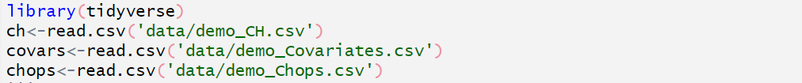
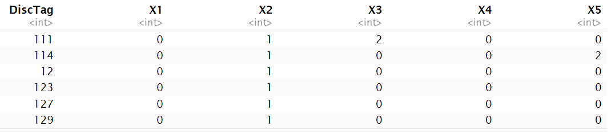
Reviewing demo data
nan=153, ns=5

Slide 11
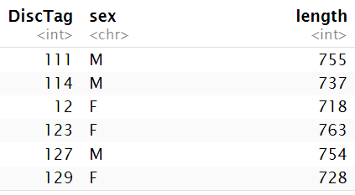
Reviewing demo data

Slide 12
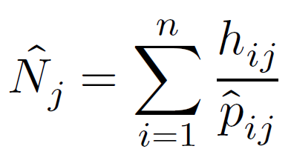
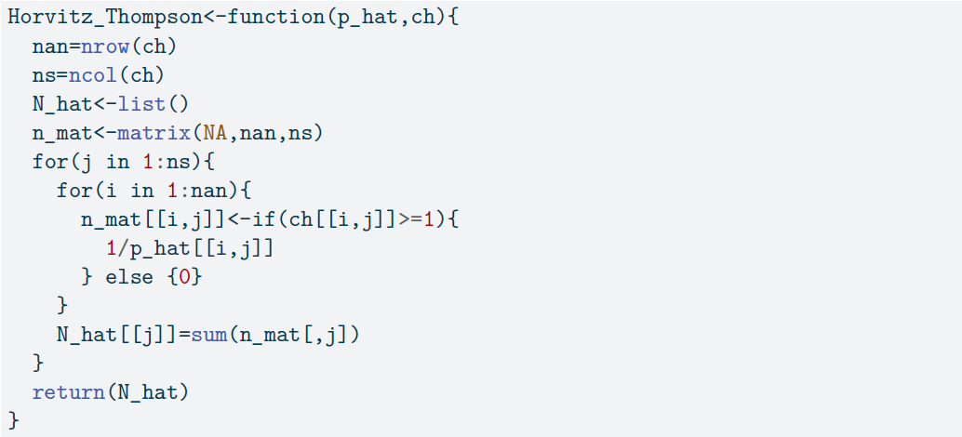
Coding – Horvitz_Thompson()

Slide 13
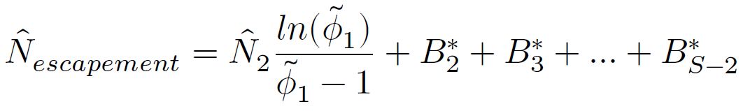
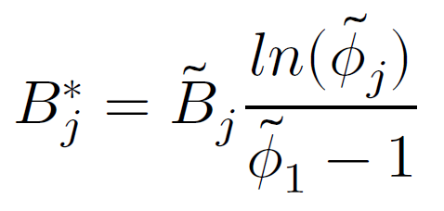
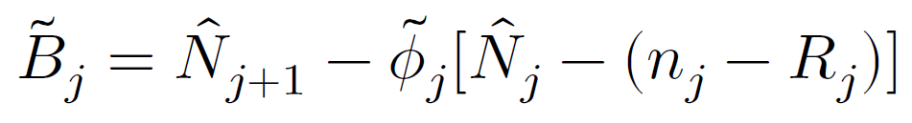
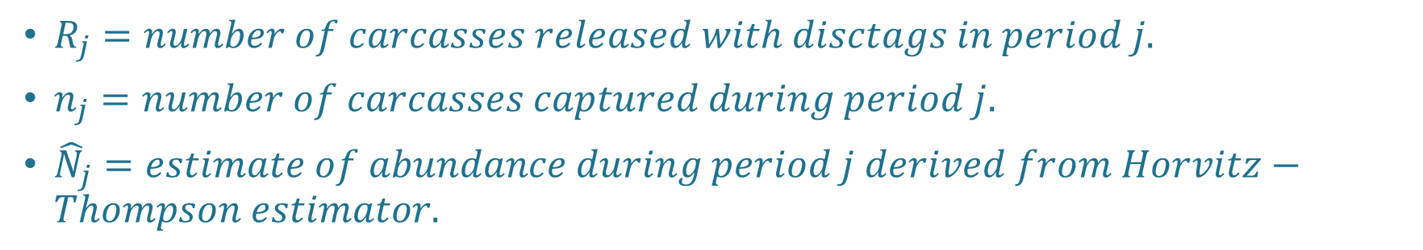
Coding – superpopulation model
${\tilde{B}}_{j}=total births for period j.$
$R_{j}=number of carcasses released with disctags in period j.$
$n_{j}=number of carcasses captured during period j.$
${\hat{N}}_{j}=estimate of abundance during period j derived from Horvitz−Thompson estimator.$

Slide 14
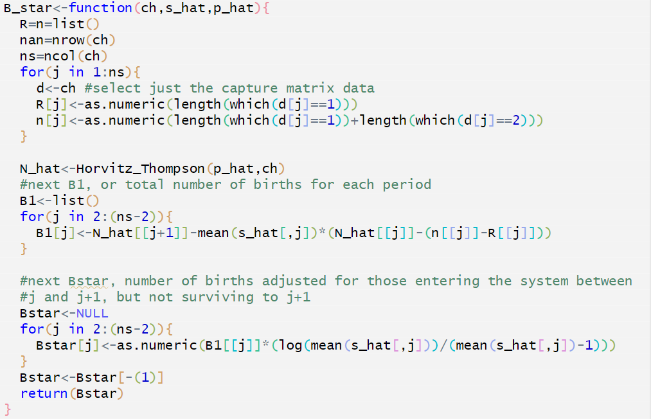
Coding – B_star()

Slide 15
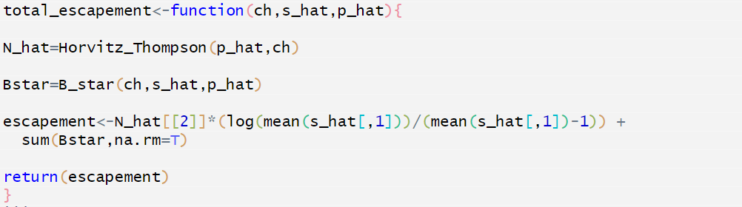
Coding – total_escapement()

Slide 16
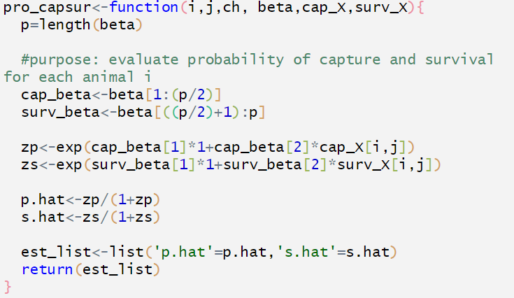
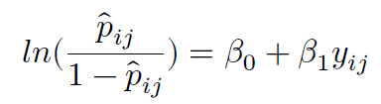
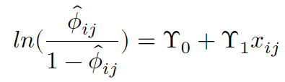
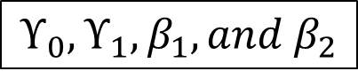
Coding – pro_capsur
$$ϒ_{0}, ϒ_{1}, β_{1}, and β_{2}$$

Slide 17
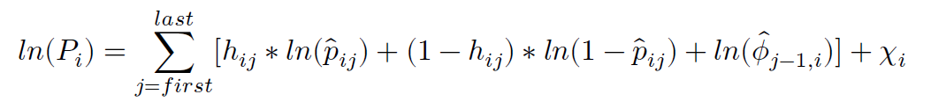
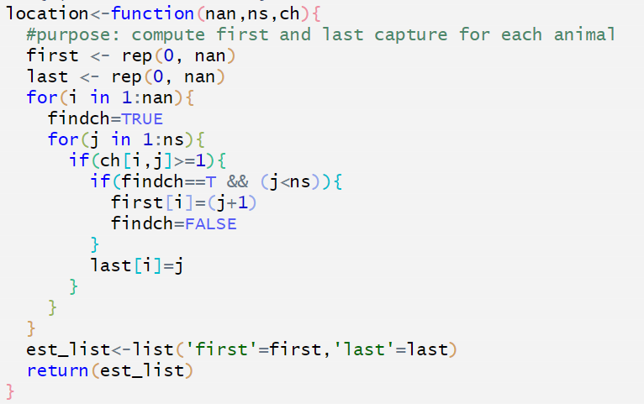
Coding – location()

Slide 18
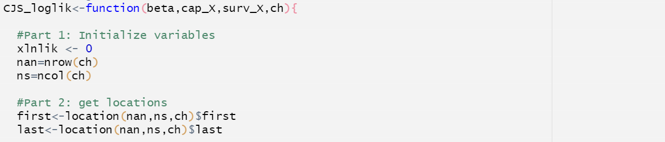
Coding – CJS_loglik()

Slide 19
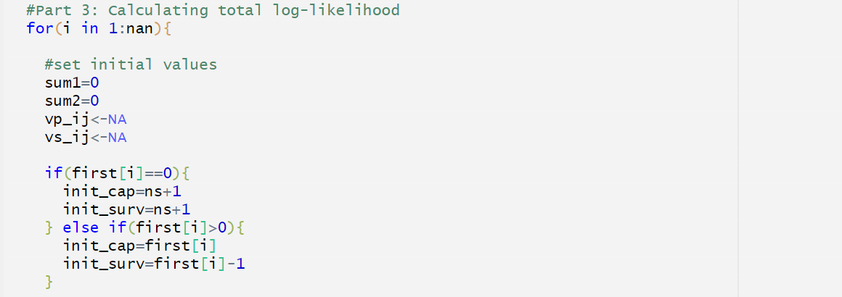
Coding – CJS_loglik()
Notes:
First(i) is never 1, because subroutine location sets first to 1 occasion after the first encounter = first estimable capture probability.
Note first(i) = 0 for histories with first capture at the last occasion

Slide 20
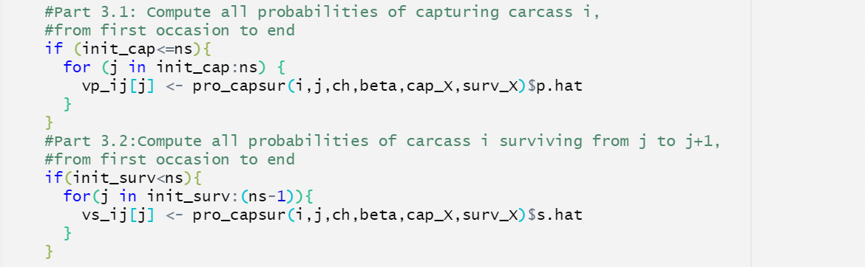
Coding – CJS_loglik()

Slide 21
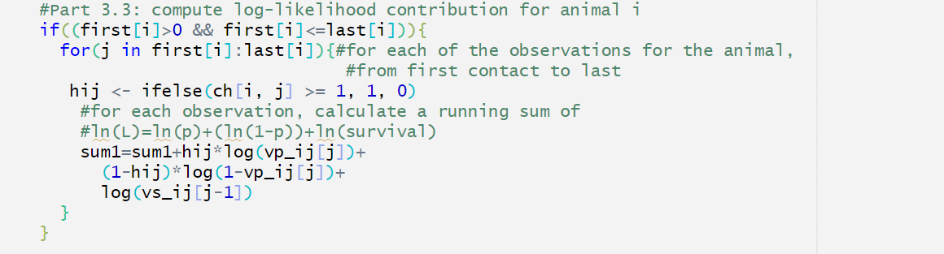
Coding – CJS_loglik()

Slide 22
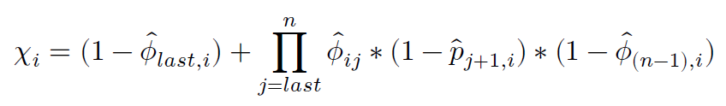
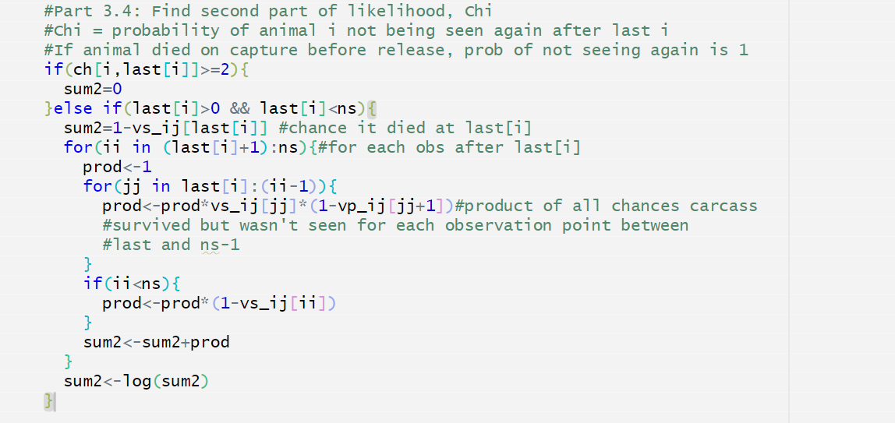
Coding – CJS_loglik()

Slide 23
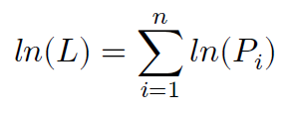
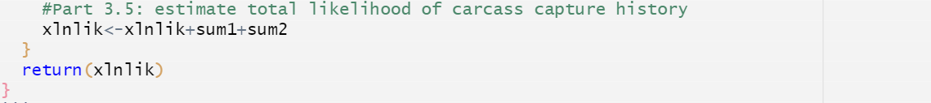
Coding – CJS_loglik()

Slide 24
Coding – CJS_loglik_wrapper()
We’ll be using the optim() call in R to find the MLE.
R optim() is a general-purpose optimization function.
optim() minimizes a function.
Using a “wrapper” function:
Allows us to maximize the function with a sign change.
Allows us to pass additional arguments that will not be optimized.

Slide 25
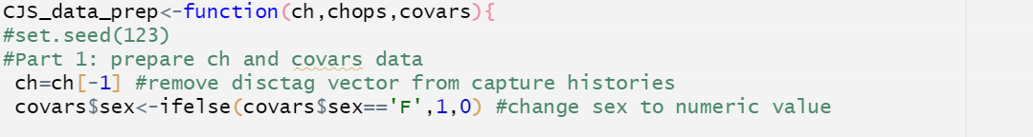
Coding – CJS_data_prep()
Data preparation function.
Deals with chopped data and sex and length covariates.

Slide 26
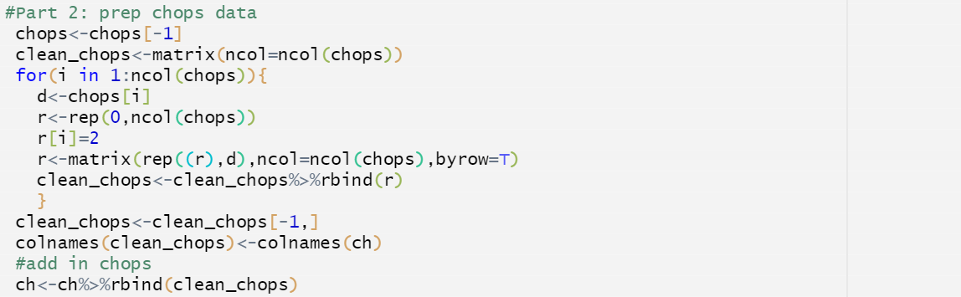

Coding – CJS_data_prep()

Slide 27
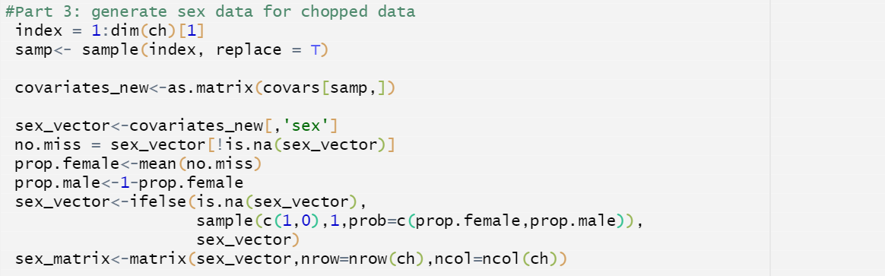
Coding – CJS_data_prep()

Slide 28
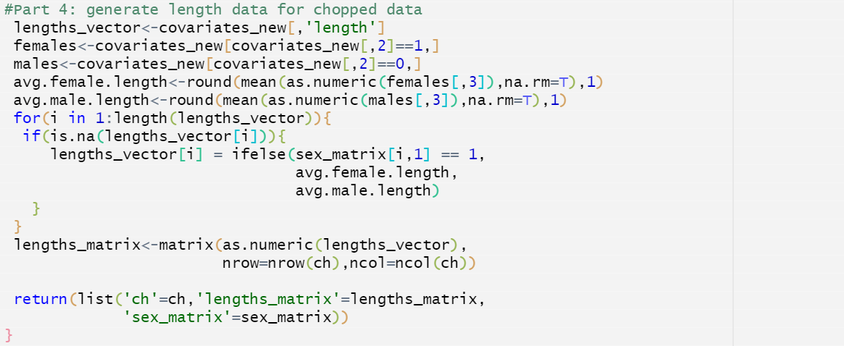
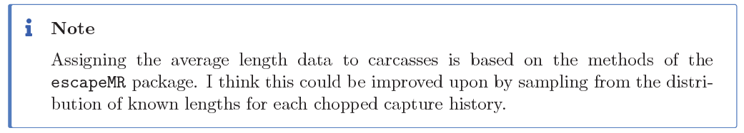
Coding – CJS_data_prep()

Slide 29
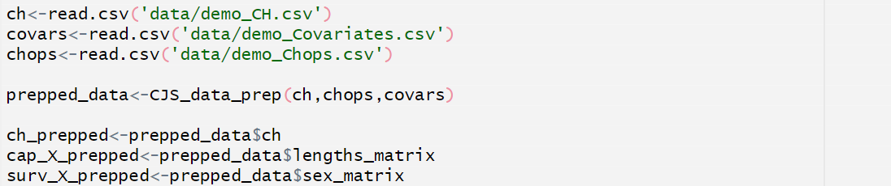
Running code – prepare data
Load demo data
demo_CH.csv
demo_Covariates.csv
demo_Chops.csv
Prep data with CJS_data_prep()

Slide 30
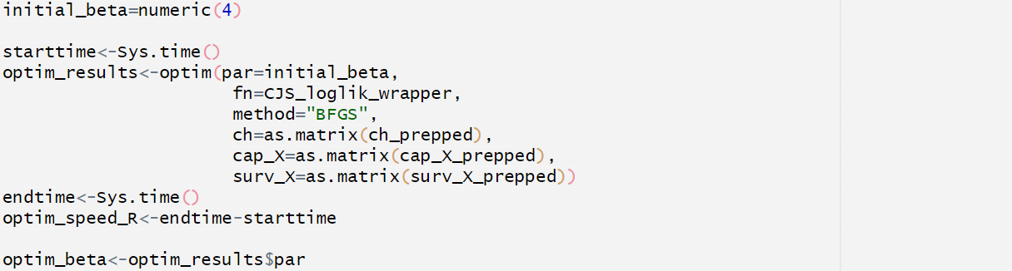
Running code – optimize parameters
Set `initial_beta`
Run optim() call
Use `Sys.time()` for testing speed

Slide 31
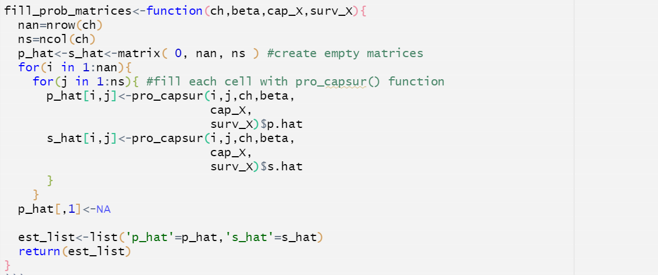

Coding – fill_prop_matrices()
Function to create matrices of $p_{ij}$ and ${\text{φ}}_{ij}$ for our observed data.

Slide 32
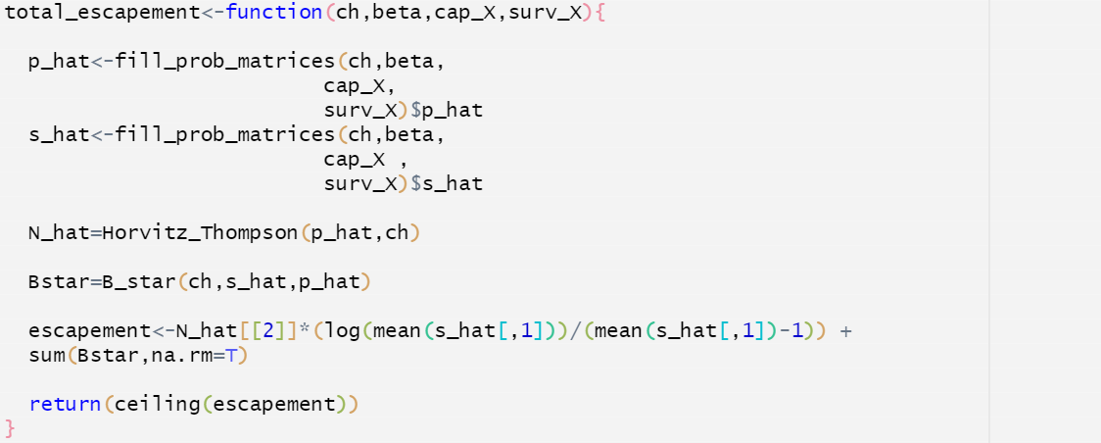
Coding – total_escapement()
Function to take optimized parameters and previously built functions to estimate total escapement.

Slide 33
Running code – estimate escapement
Run est_escapement() with optim_beta and prepped data.

Slide 34
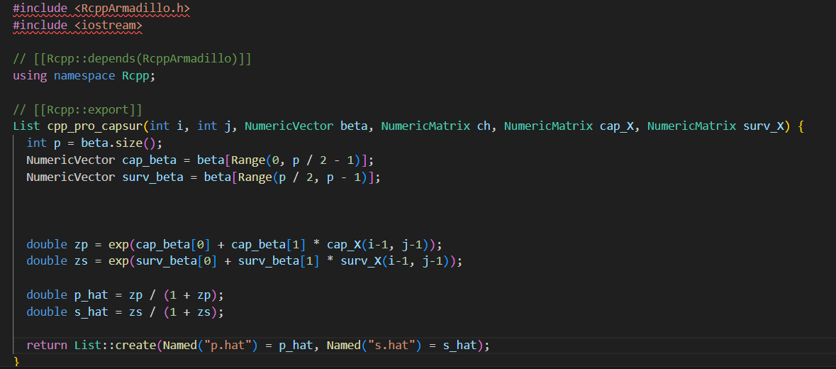
Speeding it up – incorporating C++
Original optim_speed1 ~ 3.56 seconds.
Notes:
In the C++ script, functions marked with Rcpp::export are pulled into our R environment and made available.

Slide 35
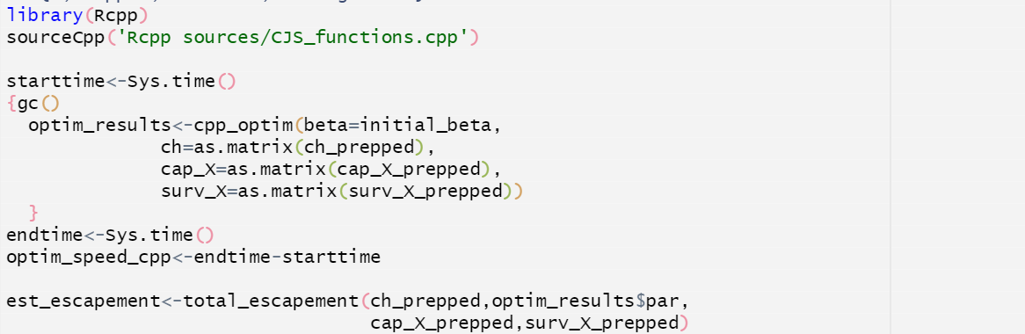
Speeding it up – incorporating C++
New optim_speed_cpp ~ 0.51 seconds.

Slide 36
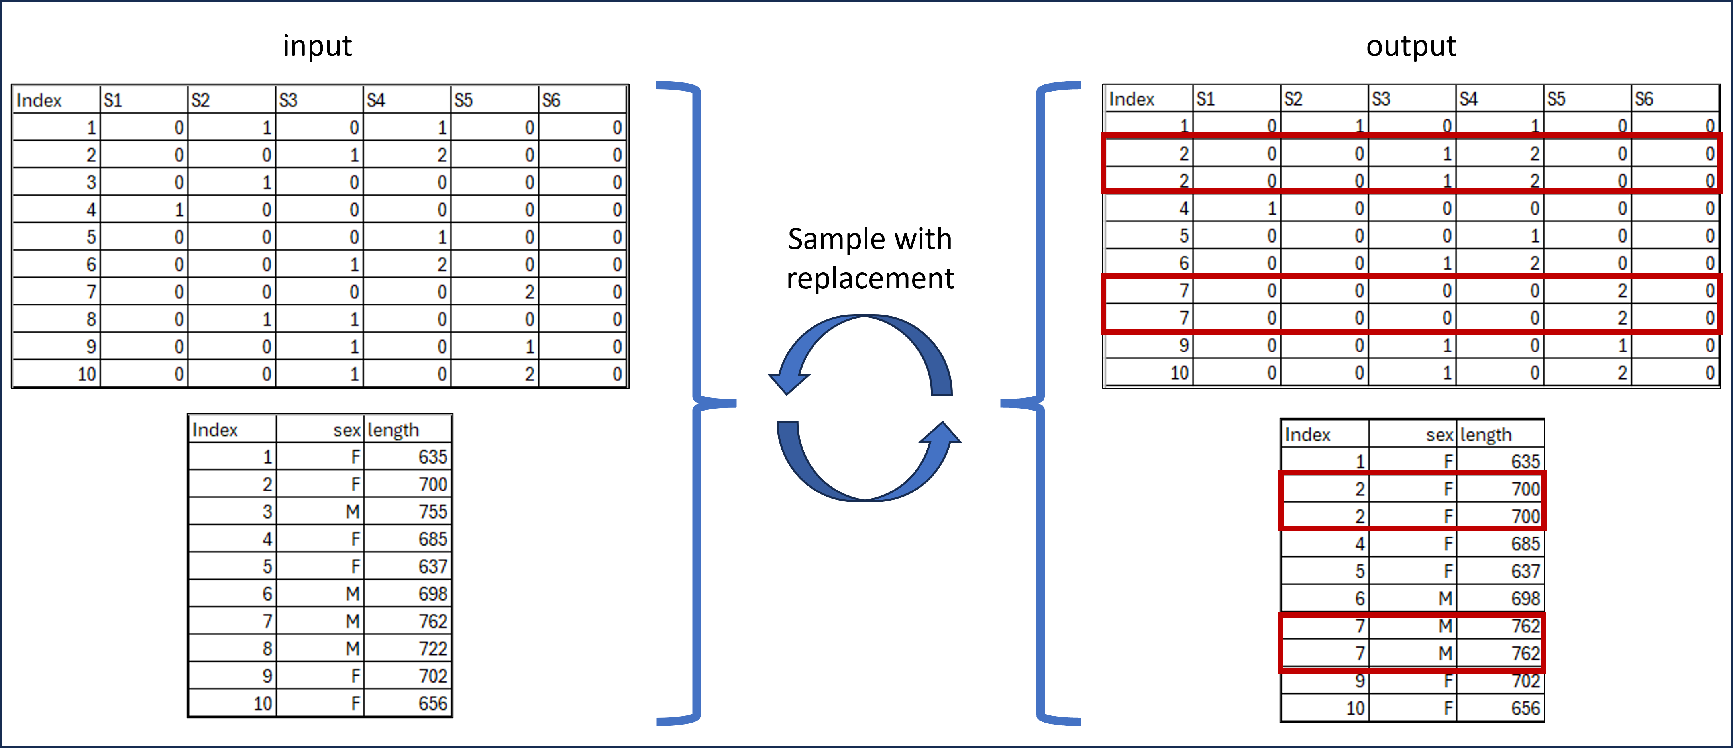
Bootstrapping for confidence intervals
Iterative resampling technique used to estimate distribution of the escapement estimate.

Slide 37
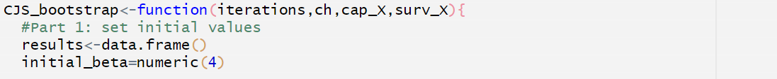
Coding – CJS_bootstrap
Input “iterations” and prepared data.
Sets initial values

Slide 38
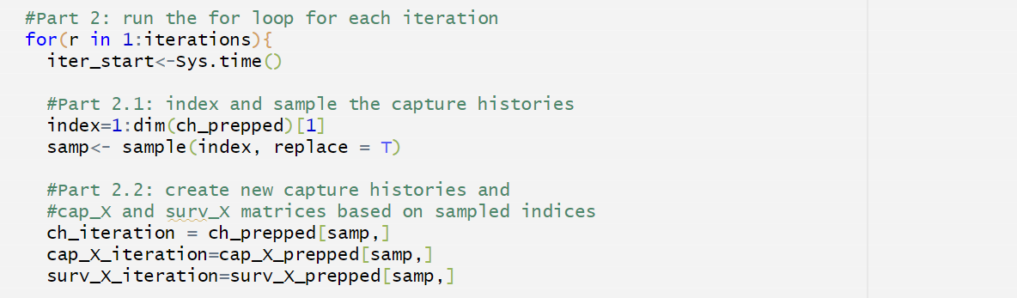
Coding – CJS_bootstrap
Begins for loop for target iterations.
Sample original prepped data with replacement.
Create new “iteration” data sets.

Slide 39
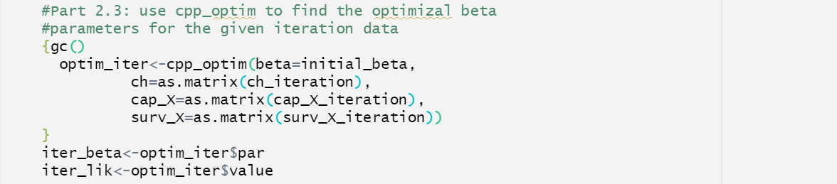
Coding – CJS_bootstrap
Use cpp_optim() to find optimized parameters for each iteration.

Slide 40
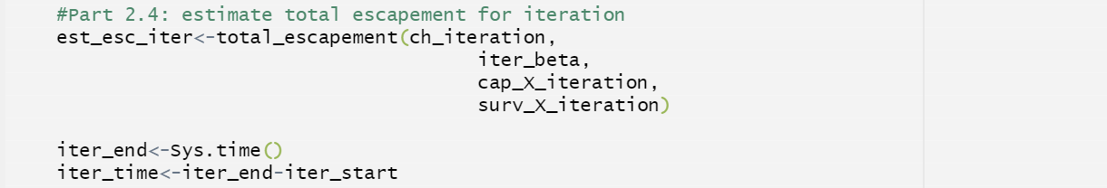
Coding – CJS_bootstrap
Run total_escapement() function using iteration data and parameters.

Slide 41
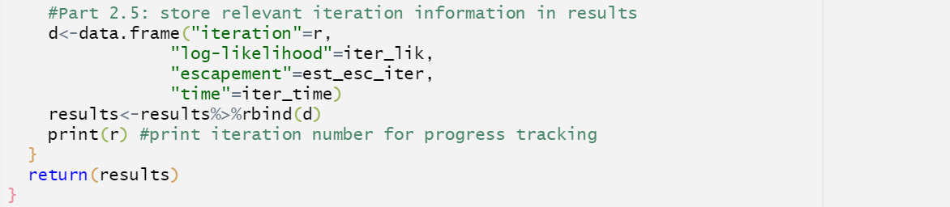
Coding – CJS_bootstrap
Store iterative results.
End for loop and return results.

Slide 42
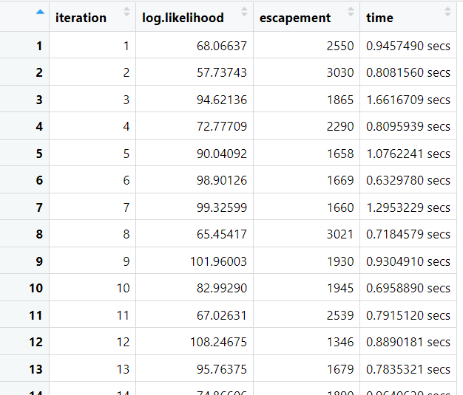
Running code – CJS_bootstrap
bootstrap_results()
Iteration number
Log-likelihood
Escapement estimate
Iteration duration

Slide 43
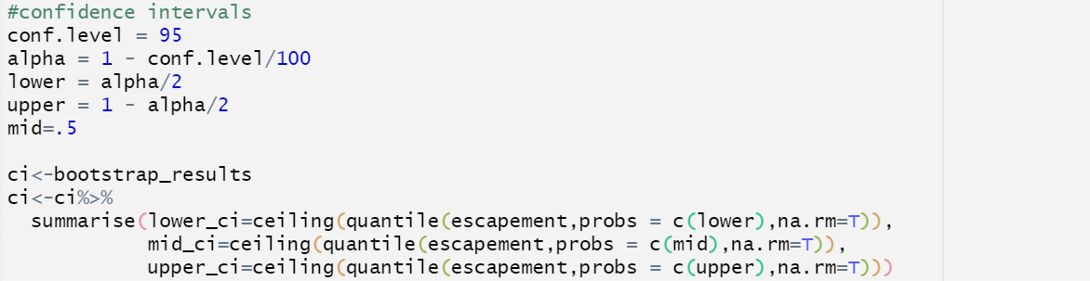
Running code – calculating CI

Slide 44
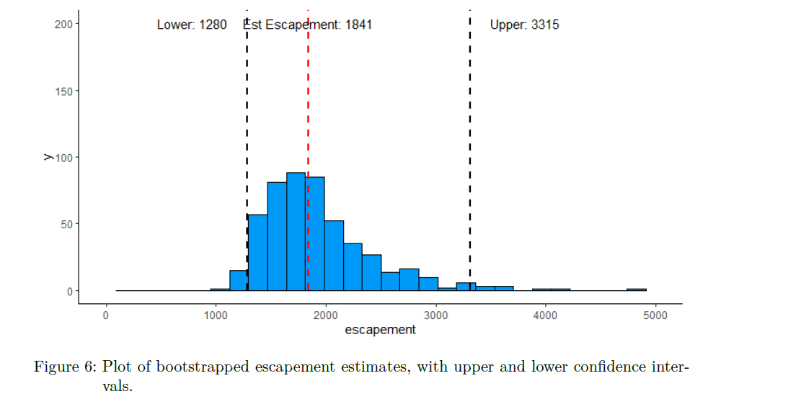
Bootstrapping results

